Slide 1
MongoDB & Redis: NoSQL Big Data Management
Exploring basic theoretical notions regarding NoSQL, together with MongoDB and Redis as implementations and their storage models

Slide 2
What is NoSQL?
Informal definition: Not Only SQL
Foundations laid in 2009 during a meetup in San Francisco
A new databases paradigm that allows for schema-less, semi-structured data with distributed storage

Slide 3
Why NoSQL?
Traditional RDBMS struggle with huge workloads that occurr when dealing with Big Data
NoSQL advocates claim that the horizontal scalability that comes with this technology, allow for better data management
In addition, flexibility suits better agile environments where data structure can change over time

Slide 4
CAP Theorem and NoSQL
(C) Consistency, (A) Availability, (P) Partition Tolerance
Proposed by Eric Brewer in 2000, it claims that between the above three properties on shared systems, only two can be achieved at once
As we will see eventually, both Redis and MongoDB are considered CP systems, even if both now implement additional techniques

Slide 5
NoSQL Data Models
Type | DBMS Implementation | Storage Model
Key-Value | Redis | Key-Value pairs
Document | MongoDB | JSON-like documents

Slide 6
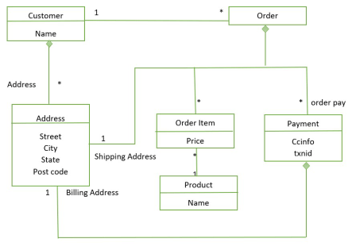
Aggregates and Schema Flexibility (1)
The foundational units in a NoSQL storage are identified as aggregates.
In the context of NoSQL, it is important to correctly identify aggregates in data when modelling information, so that querying and distribution can be performed efficiently
Two main aggregates: Order and Customer A single logical address appears 3 times in the data
6

Slide 7
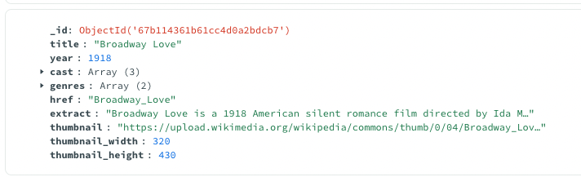
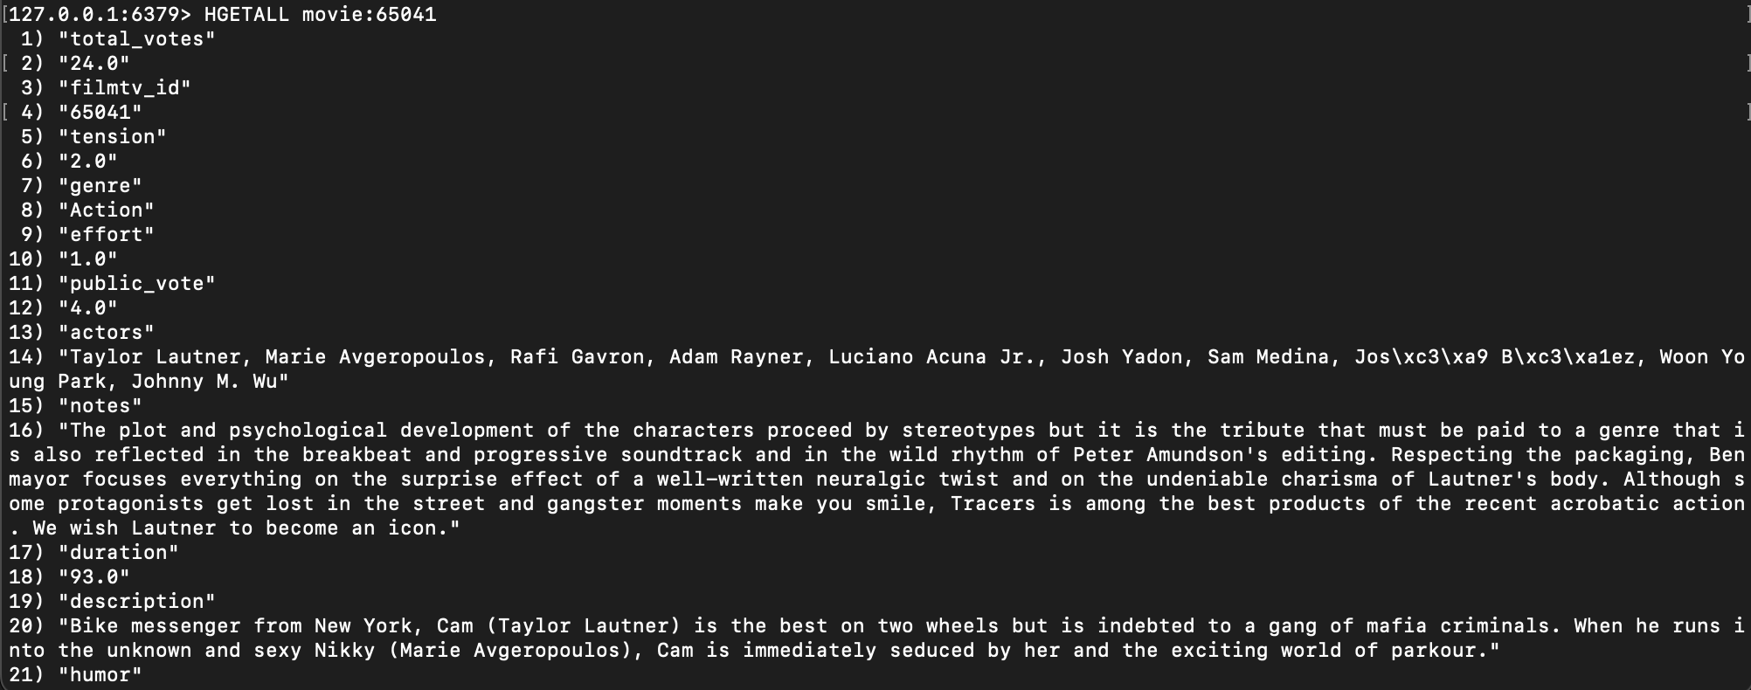
Aggregates and Schema Flexibility (2)
In MongoDB, an aggregate is represented by a single document
In Redis, an aggregate is a key-value pair

Slide 8
Introduction to Key-Value Storage
Key-Value stores allow for fast access to data via key lookups
They work like a huge hash map, where data is stored and retrieved by means of a key
They are mainly used in ambits like caching data, and session management for users

Slide 9
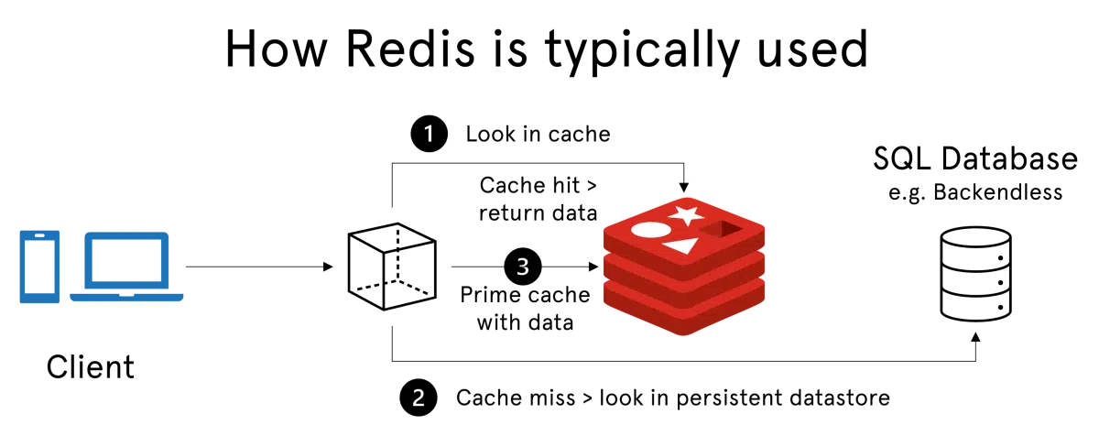
Redis Typical Use Case

Slide 10
How Redis Stores Data (1)
Redis, in contrast to traditional DBMS, exploits an in-memory storage to fastly retrieve data.
Each blob of data (value) can be of multiple types:
Simple strings
Hashes, conceptually similar to dictionaries
Lists and sets (also sorted)

Slide 11

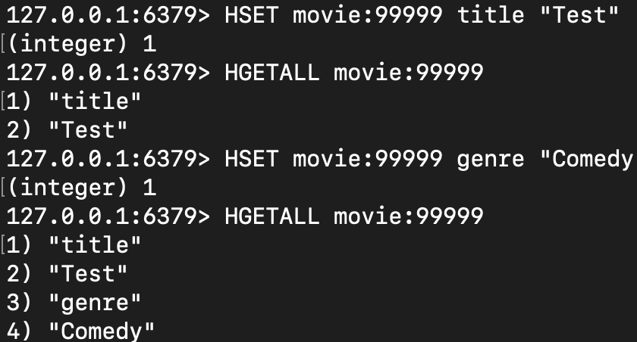
How Redis Stores Data (2)

Slide 12
How Redis Maintains Data (1)
Since Redis is an in-memory data storage, there must be a way to synchronize data to disk to prevent loss of information when the server is restarted.
Two main techniques are used to persist information: RDB and AOF.

Slide 13
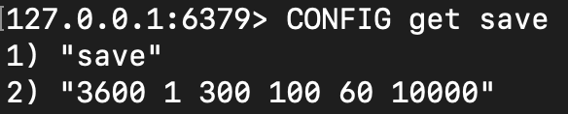
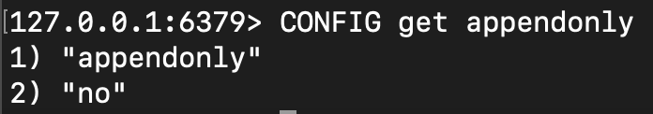
How Redis Maintains Data (2)
RDB (Redis Database File): data is stored on disk with a snapshot of the dataset at configured intervals. It is enabled by default
AOF (Append-Only File): every write information is stored on a log file, and it can be replayed in case of data loss

Slide 14
How Redis Maintains Data (3)
In the basic setting, Redis runs on a single server with a single thread, hence it allows a good degree of consistency by exploiting the techniques of RDB and AOF.
However, it is also possible to increase availability, losing some degree of consistency in a trade-off for availability (CAP theorem)

Slide 15
How Redis Ensures Consistency
Consistency is ensured natively, since Redis is single-threaded and runs in the basic setting on only one server instance.
Nonetheless, when scaling horizontally with Redis Cluster or when increasing availability with Master-Replicas server, we may lose some degree of consistency.
Additionally, if we want to execute a sequence of commands without being interrupted by other clients’ executions, Redis supports transactions.

Slide 16
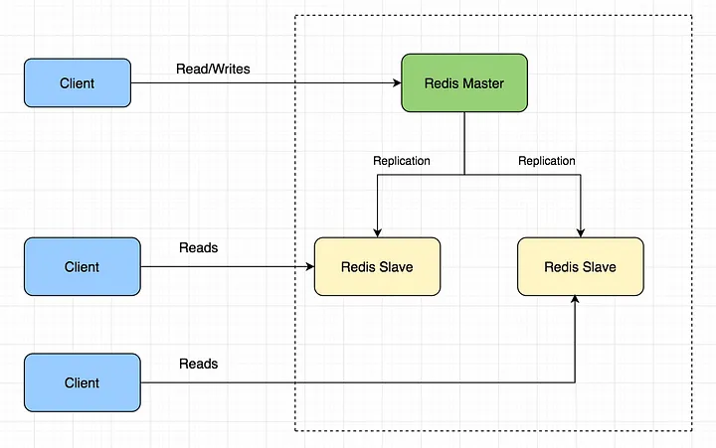
How Redis Ensures Availability (1)
When scaling horizontally, a server can be either run as a Master or a Replica (Slave):
In a typical setting, clients communicate with Master instances to write data, and the Master will asynchronously communicate with its replicas

Slide 17
How Redis Ensures Availability (2)
In the context of Availability, if one instance fails, we have two cases:
If a Replica Server fails, we simply create another replicating all data from the other Replica
If a Master Server fails, two approaches are possible
We can add a new server as Redis Master
We can ‘promote’ an existing Replica to the role of Master

Slide 18
How Redis Ensures Availability (3)
Since the Master Server asynchronously updates its replicas when a write request comes from a server, in case a failure occurs during the Master-Replica update, the new data is lost
No strong consistency guaranteed!

Slide 19
How Redis Performs Scaling (1)
Due to the need in Big Data Management to deal with large-sized information, Redis adopts a deployment topology called Redis Cluster that allows to scale horizontally.
With Redis Cluster, it is possible to automatically split data in multiple nodes, increasing the overall throughput of the system.

Slide 20
How Redis Performs Scaling (2)
Data is sharded through an hashing system, where every key is part of an hash slot computed by the modulo 16384 of the key.
Finally, it is also possible to integrate Redis Cluster with the Master-replica model in order to increase the level of availability.

Slide 21
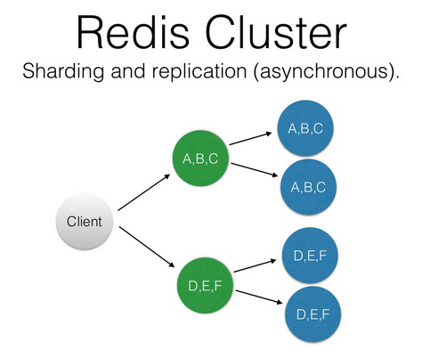
How Redis Performs Scaling (3)

Slide 22
Redis indexing and queries (1)
Redis allows direct access to key-value pairs by knowing the key, which can be semantically meaningful (e.g. user:userId) with complexity O(1).
However, when dealing with hash values, access to secondary key is also possible, by exploiting Redis additional data structures.

Slide 23
Redis indexing and queries (2)
There are two main types of indexes:
Inverted index: used when indexing string fields inside hashes, for every term a specific list is maintained with the set of all documents containing this term
Numeric index: a binary range tree where each numeric value is a node is maintained, so that also range operations can be performed

Slide 24
Introduction to Document-Based Storage
Similarly to key-value stores, also document-based storages store and retrieve data by means of an ID
However, they were born to support structures such as array and data types inside every document
Thus, it is is natively possible to perform queries and aggregations on single fields

Slide 25
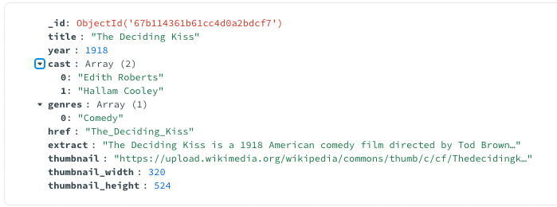
How MongoDB Stores Data (1)
In MongoDB, data records are stored as BSON documents BSON is simply a binary representation of JSON documents, that extends some data types not available in JSON like dates, binary data, and also contains information like field length

Slide 26
How MongoDB Stores Data (2)
Documents are gathered together in collections, which are ideally equivalent to RDBMS tables. In turn, a collection is part of a single database.
MongoDB documents are:
Polymorphic: fields can change from document to document within a single collection
Self-describing: No need to declare fields priorly, they are described on-the-fly when creating and updating documents

Slide 27
How MongoDB Stores Data (3)
Conversely to Redis, MongoDB stores data permanently on disk.
To ensure a greater level of data durability, however, it also exploits a system of checkpoints and data journal (similar to Redis AOF) which is also used during transactions to ensure consistency.

Slide 28
How MongoDB Ensures Consistency
Operations that affect single documents within a collection are natively consistent.
For cases when an operation updates multiple documents within one or more collections, MongoDB supports transactions.
Transactions can also be executed on multiple Shards or Replica Sets.

Slide 29
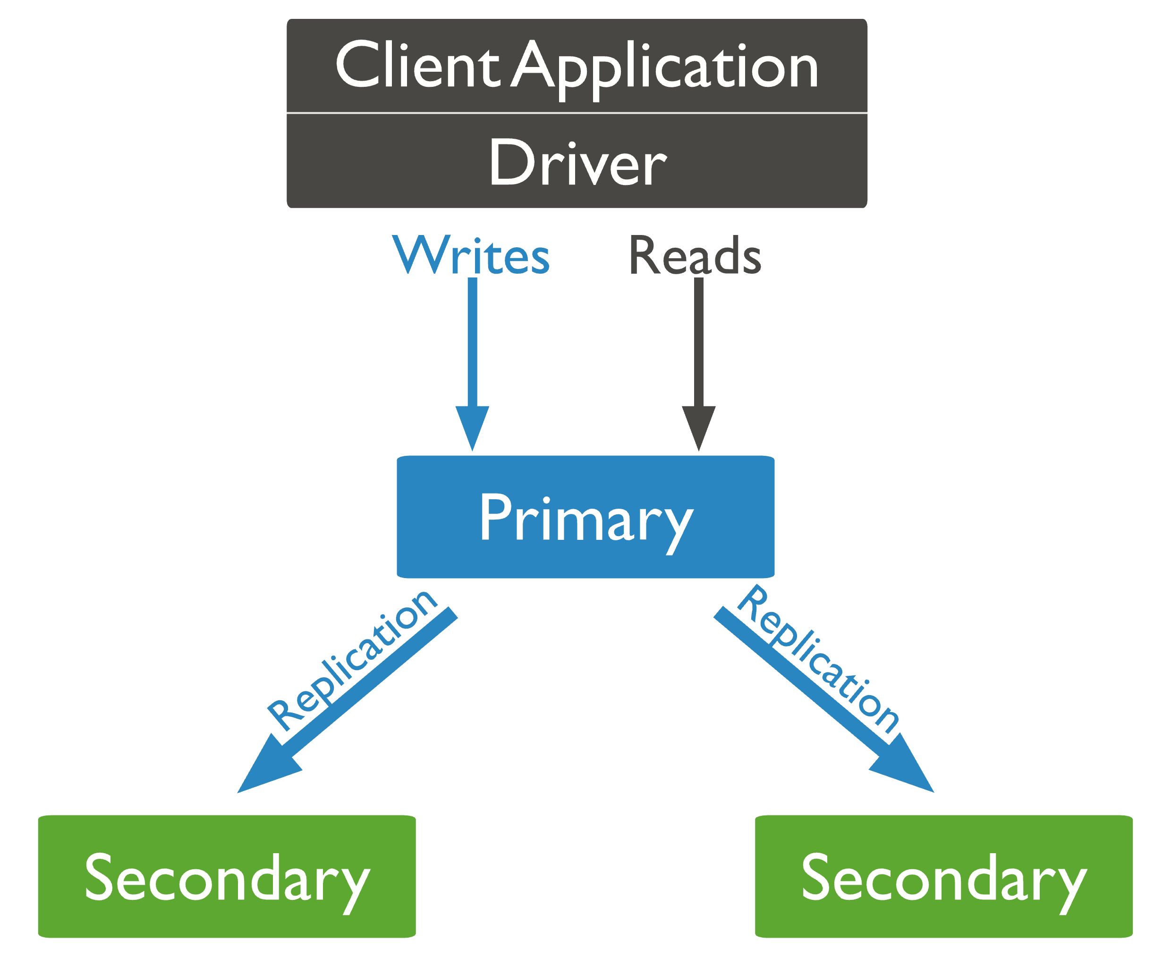
How MongoDB Ensures Availability (1)
Similarly to Redis, MongoDB provides increased data availability by replicating data inside a Replica Set

Slide 30
How MongoDB Ensures Availability (2)
The primary node receives all read and write operations, while the secondary nodes only perform replicate these operations asynchronously such that their data set reflects the primary one.
When a primary node fails, a secondary node can ‘propose’ himself as the new primary, and elections are held. A special type of node called Arbiter can be added, that doesn’t hold any data but can vote in an election.

Slide 31
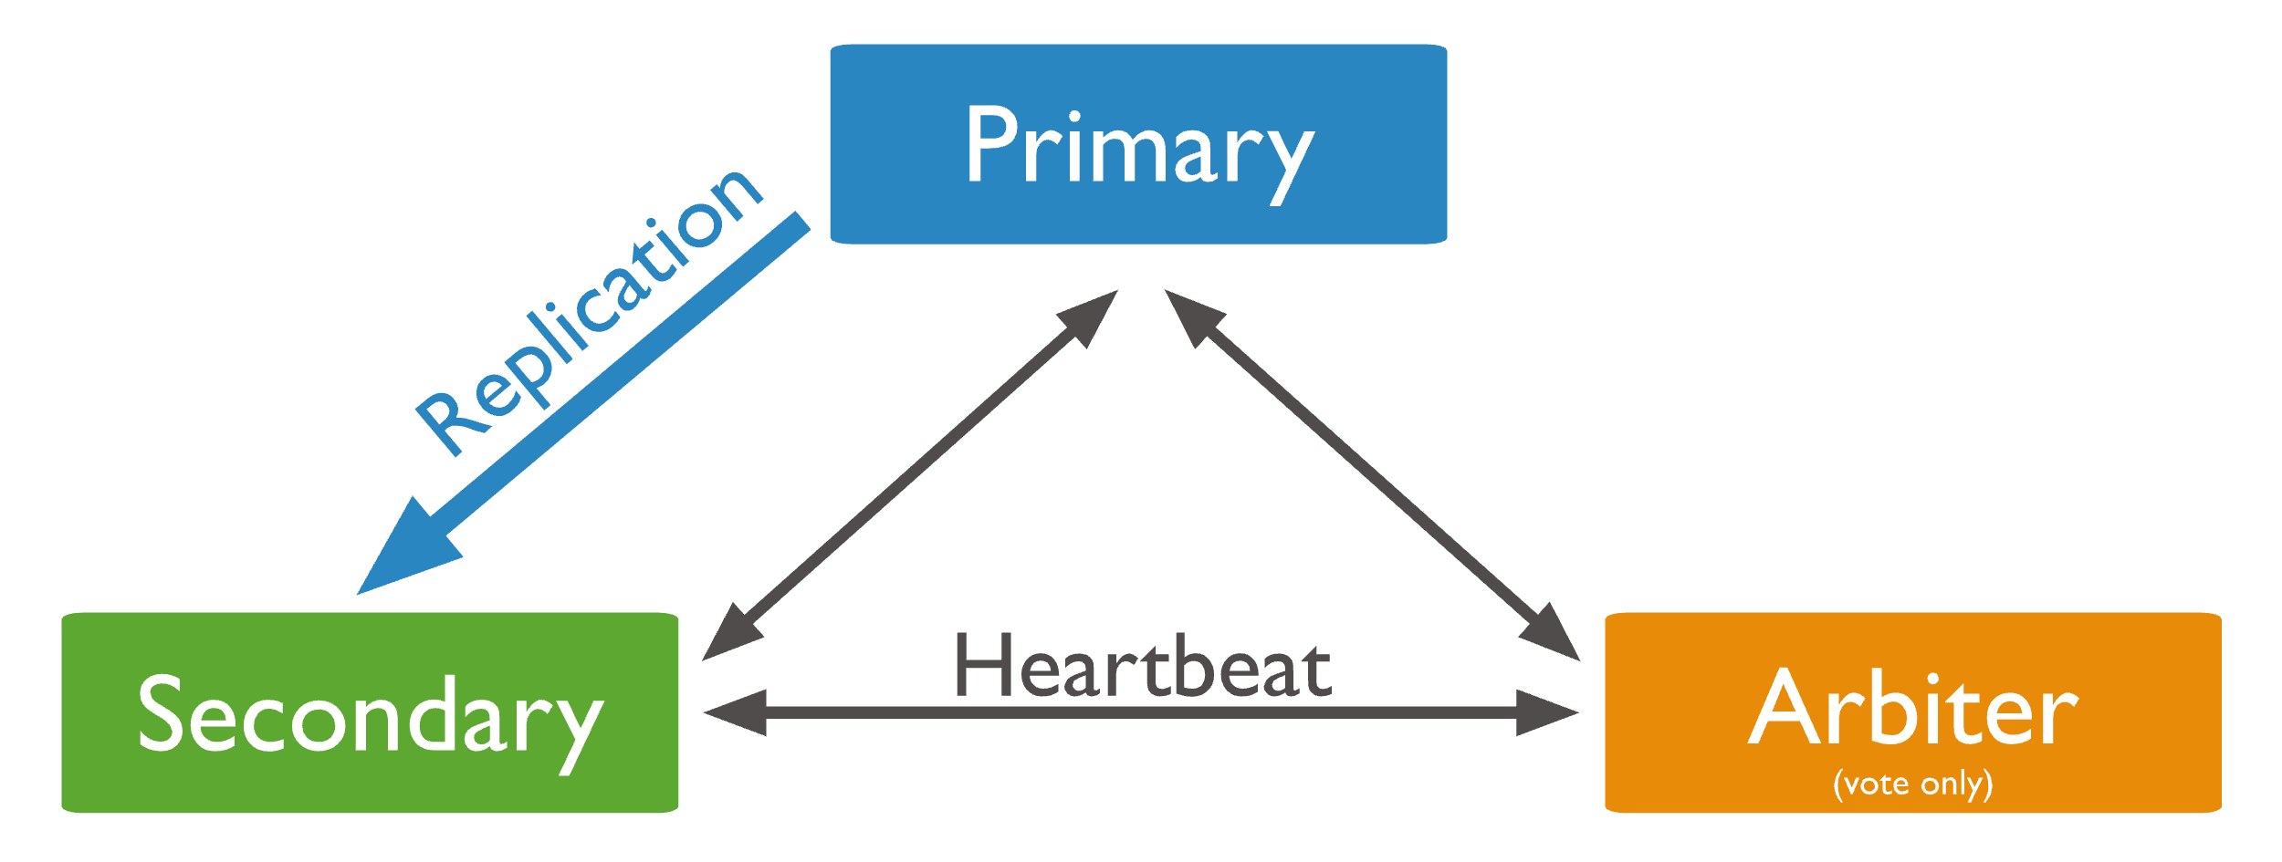
How MongoDB Ensures Availability (3)
Every two seconds, each member of the Replica Set can send an ‘heartbeat’ (ping) to every other member. If a member does not answer, it is marked as inaccessible

Slide 32
How MongoDB Performs Scaling (1)
Just like Redis, MongoDB was developed with the clear goal of handling massive datasets that power Big Data use cases.
The same technical solution is implemented: horizontal scaling by means of sharding

Slide 33
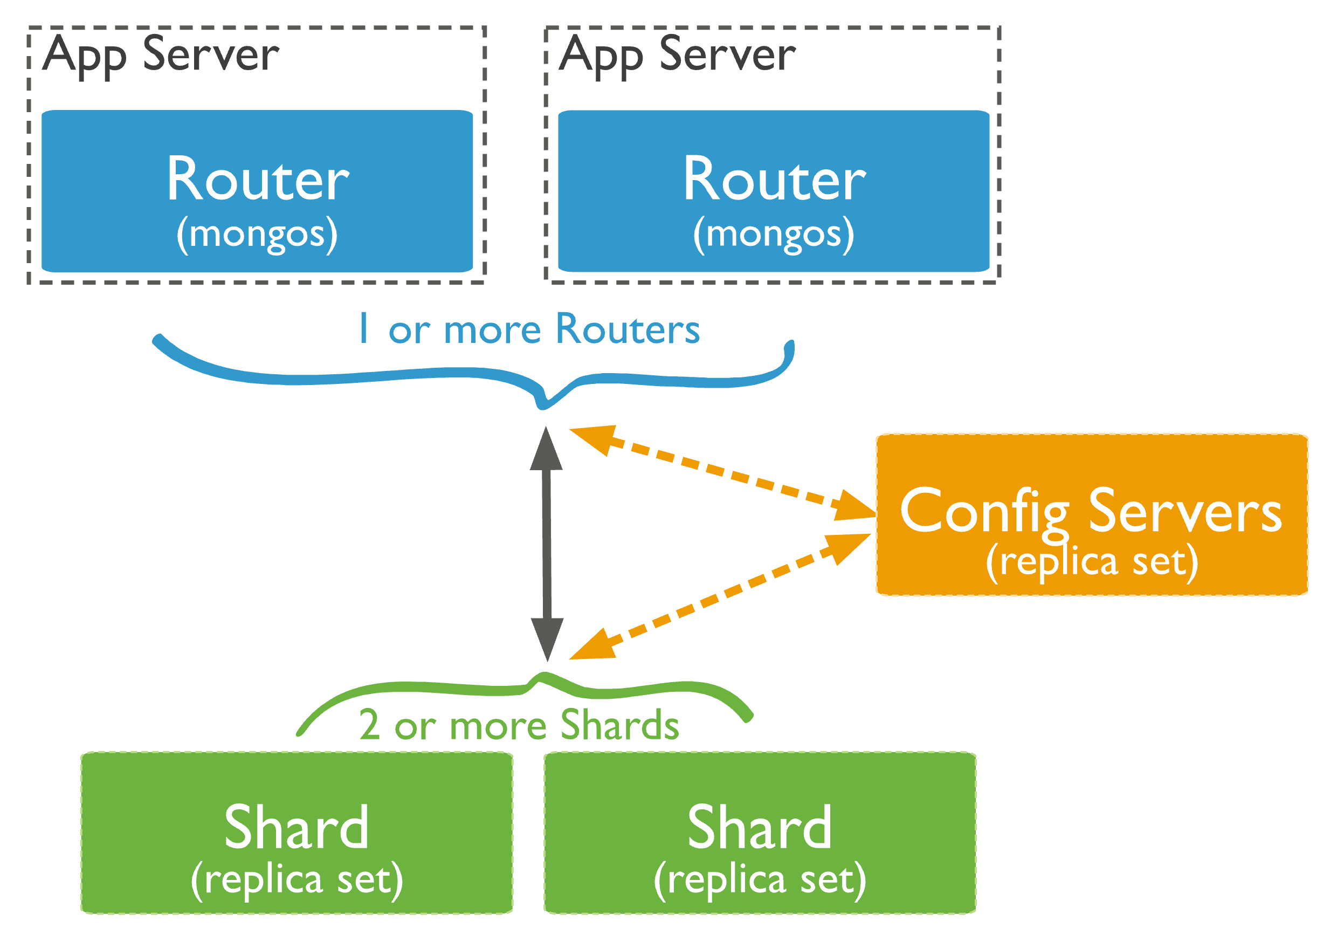
How MongoDB Performs Scaling (2)
Inside a sharded cluster, three main components are located:
Config servers: store metadata and settings for the cluster
Mongos: Interface between application and shards, query router
Shard: Actual Replica Set that contains data

Slide 34
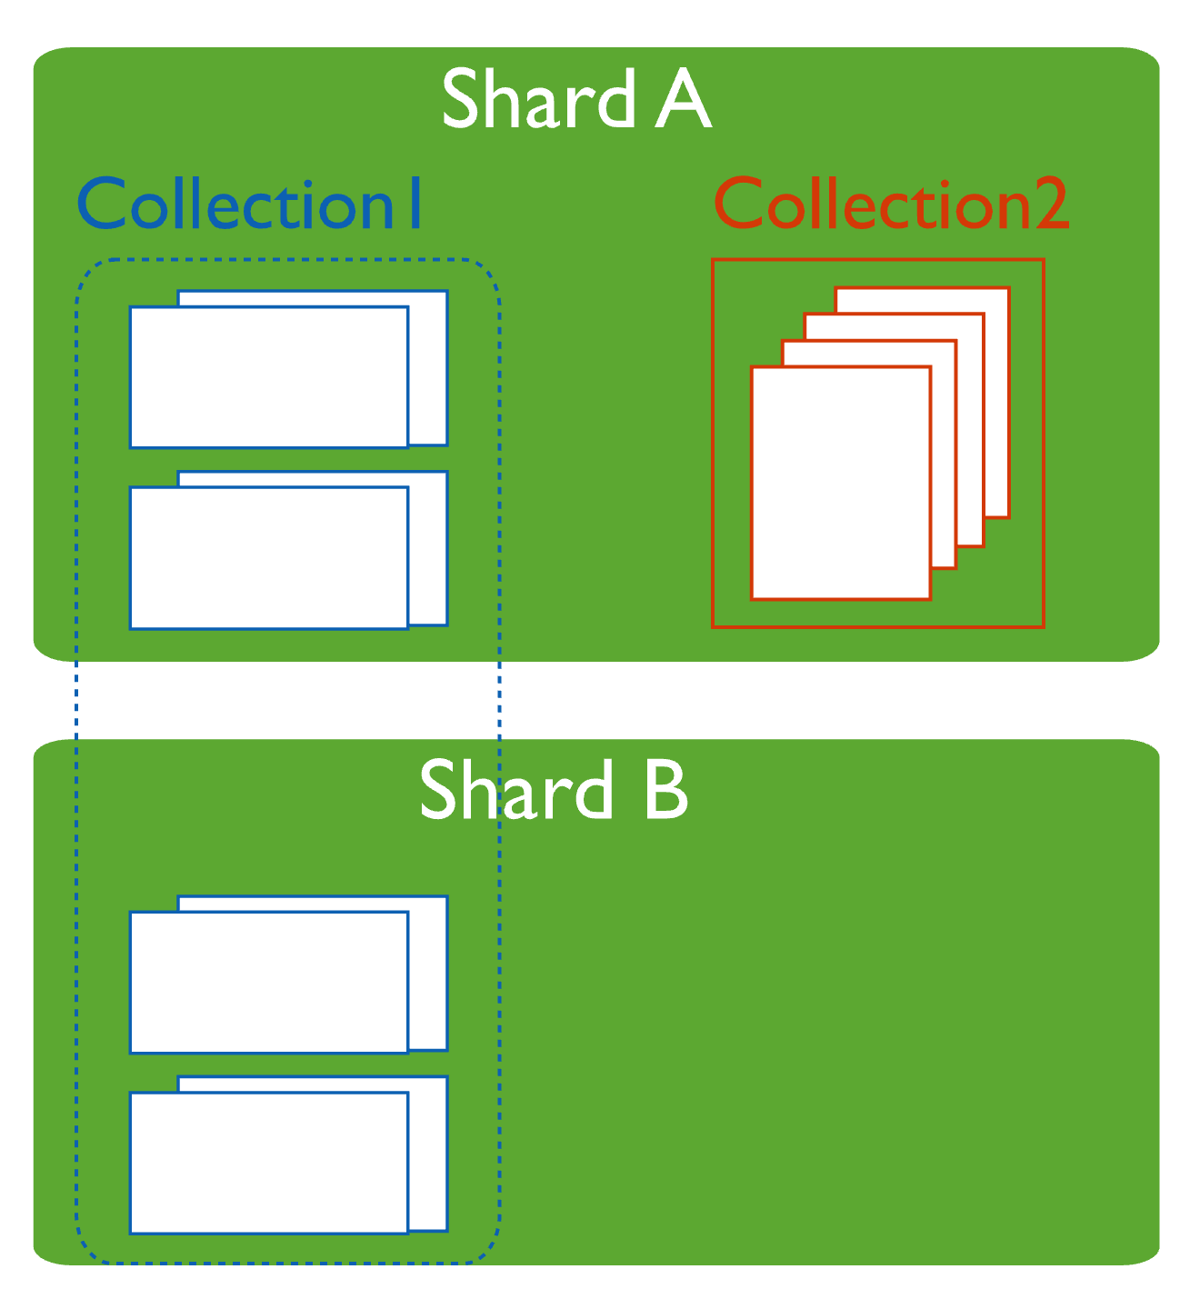
How MongoDB Performs Scaling (3)
MongoDB uses shard keys to distribute the documents of a collection across shards.
A shard key is composed by one or more document fields which are declared when sharding a collection.
It is possible to have some sharded collections, whose content is distributed across partitions, while keeping unshared collections that can be located (entirely) on any shard.

Slide 35
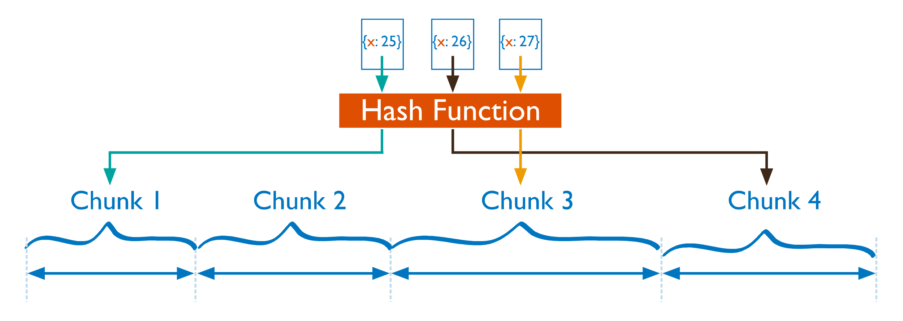
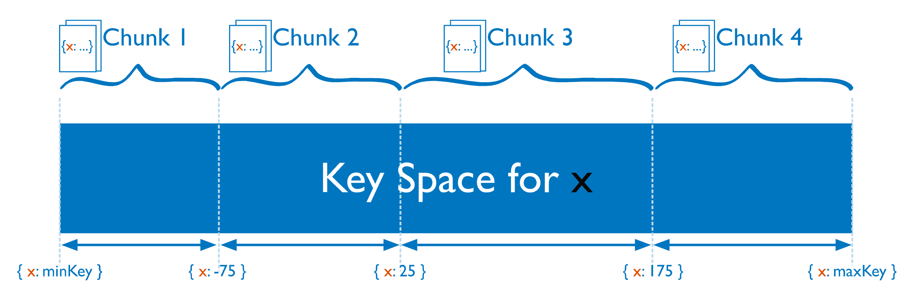
How MongoDB Performs Scaling (4)
MongoDB supports two different strategies for distributing data between shards:
Hashed sharding: computed by hashing the shardkey
Ranged sharding: dividing data based on ranges defined on the shard key values

Slide 36
Redis and MongoDB Recap (1)
 | Redis | MongoDB
Data Model | Key-Value | BSON Documents
Data Storage | In Memory | On Disk
Consistency | By default + transactions-like supported (multi-command ops) | By default + transactions supported (multi-collection ops)
Querying | Key lookups + optionally RediSearch, indexes specified priorly | Any field
Scalability | Yes, but harder to maintain with hashing | Yes, automatic data distribution
Availability | Possible, but no automatic failover detection | Natively supports automatic failover detection

Slide 37
Redis and MongoDB Recap (2)
Redis: Best for in-memory speed, caching, session management, with limited query support unless using RediSearch
MongoDB: Best for flexible document storage, complex queries, and high write/read scalability via sharding

Slide 38
…Thanks!
References:
Theoretical notions: LSDM Course taught by prof. Antonella Poggi
Redis documentation
MongoDB documentation
GitHub: LSDM-Big-Data-Management

